Slide 1



Project presentation
Quiz system website
Under supervision
Dr.Enas Elgeldawi.
Eng. Hamada magdy.

Slide 2
Students participating in the project
Student Name | ACADEMIC ID
Abanoub Kamal Shehata | 2100226
Romany Morad Ezat | 2101906
Felopater Maged Makram | 2102001
Beshoy Gamal Waheb | 2101883
Samuel Kamal Fouad | 2101949
Momen Montaser Atia | 2102105
Mina Eshak Ramzy | 2101111

Slide 3

Content of Presentation
02
04
06
Problem Statement
Software Specifications
Project
modules
01
07
03
05
Objectives
requirements
User
Characteristics
Project
Goals

Slide 4

Objectives of Online Exam system
Improve teaching through an online examination system.
efficient platform for educational institutions.
Reduce exam time and result processing for both instructors and students.

Slide 5
Problem Statements
Traditional exam are time consuming to manage results .
Errors may accur when manually generating results .
Students should see their results immediately after completing exams .

Slide 6
Project Goals of Online Exam
Online Examination system is designed for Educational Institutions .
Provides three levels of question difficulty (easy, moderate, hard) .
It can be used anywhere any time as it is a web based application.
It reduces the time of taking examinations of the students manually.
Automatic assessment and feedback for quizzes.

Slide 7
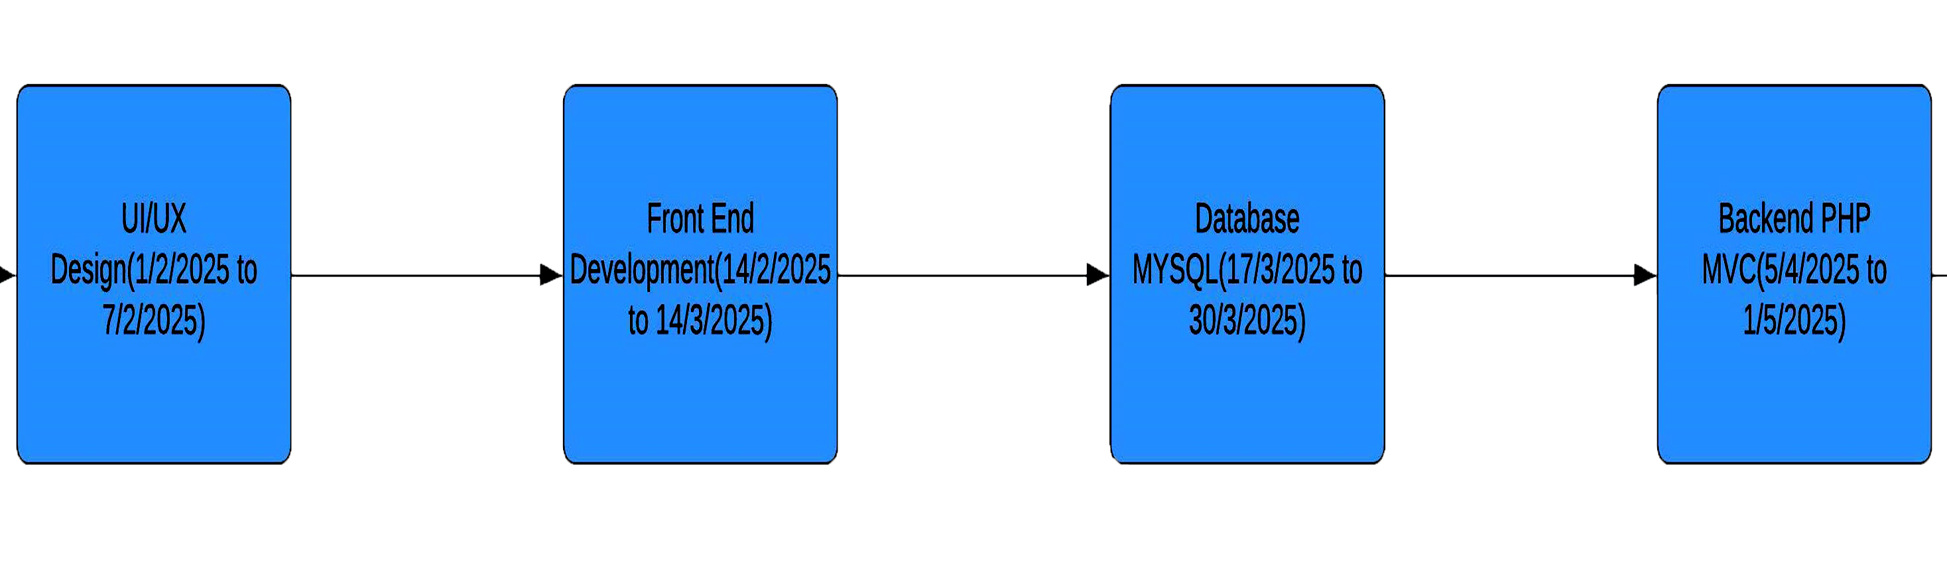
Agile planning

Slide 8

Software Specifications
XAMPP Software
Model
View
Controller
Software
Other Language
MVC
HTML
CSS
JAVA SCRIPT
Bootstrap
PHP
MySQL
Programming Language
Database

Slide 9
User Registration and Authentication
- Users can create accounts.
- Users can log in and log out.
- Password recovery functionality.
Quiz Creation and Management
- Admins can create, edit, and delete quizzes. - Create questions using AI
- Ability to add questions of various types (multiple choice, true/false, etc.).
- Option to set time limits for quizzes.
User Participation
- Users can take quizzes.
- Immediate feedback on answers.
- Ability to review results after completion.
Scoring and Leaderboards
- Automatic scoring of quizzes.
- Display of user scores and rankings.
- Option for users to view their quiz history.
Functional Requirements

Slide 10
Question Bank Management
- Ability to categorize questions.
- Randomization of questions in each quiz for each student.
Reporting and Analytics
- Admins can view overall statistics on quizzes and user performance.
Notifications
- Email notifications for new quizzes and reminders for upcoming quizzes.
Functional Requirements

Slide 11
Performance
- The system should handle multiple users simultaneously.
- Quick response times for loading quizzes and submitting answers.
Usability
- User-friendly interface that is easy to navigate.
Security
- Secure user data storage and transmission (HTTPS).
- Protection against SQL injection and other vulnerabilities.
Non-Functional Requirements

Slide 12
Scalability
- Ability to accommodate an increasing number of users and quizzes
Compatibility
- The website should work across different browsers and devices (responsive design).
Maintainability
- Code should be modular and well-documented for easy updates.
- Regular backups of data.
Non-Functional Requirements

Slide 13
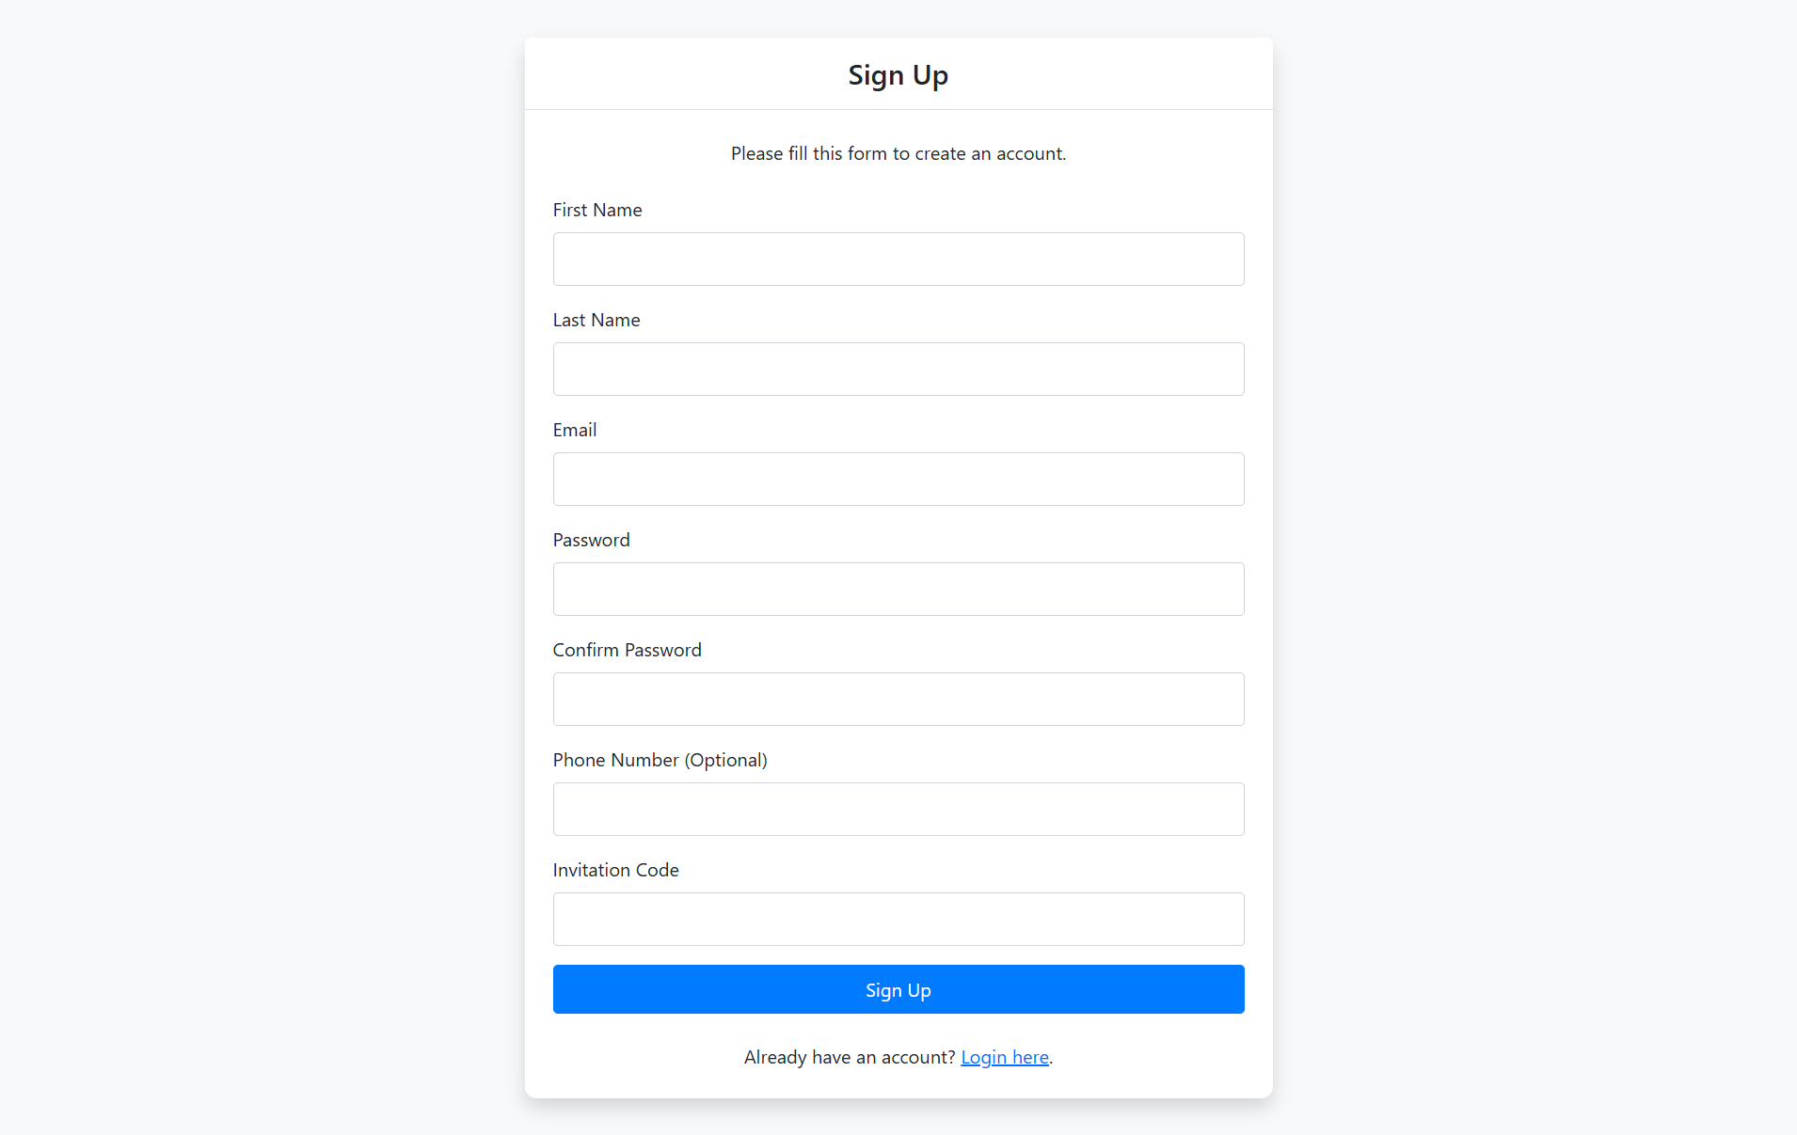
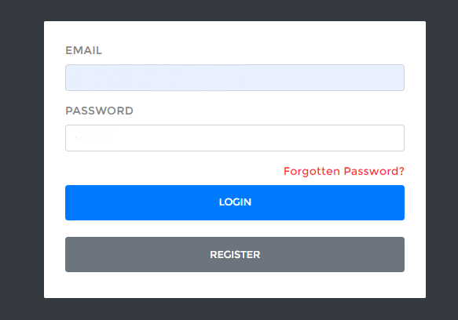
Login Account Module
1. User Authentication Identify :
Instructors and Admins can log in using this form by entering their email and password.
Admins are authenticated based on specific credentials that verify their admin status.
The system checks the entered email and password against the database to ensure the credentials are correct and that the user has the appropriate access level (admin or instructor).

Slide 14
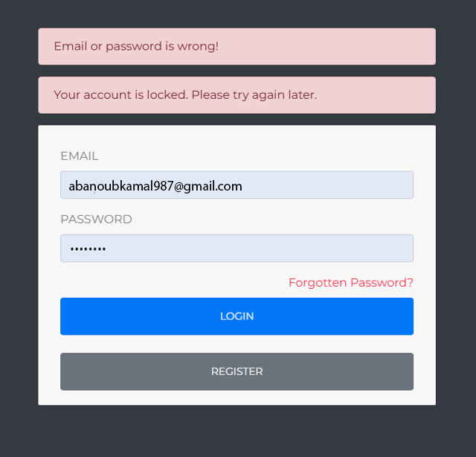
Login Account Module
2. Login Process:
Email Field: Users must enter their registered email address. This is used to identify the user in the system.
Password Field: Users must enter their password. The system hashes this password and compares it with the hashed password stored in the database.

Slide 15
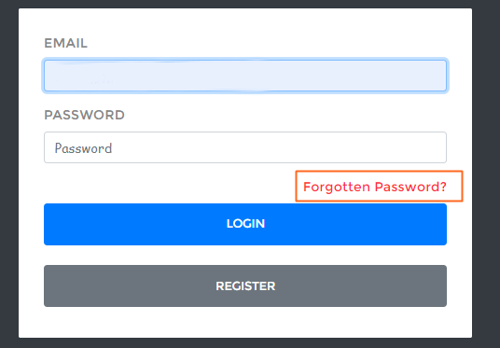
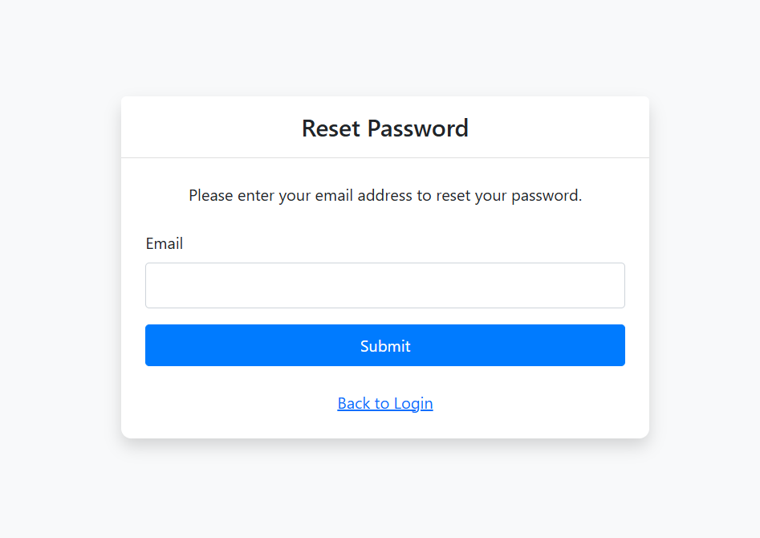
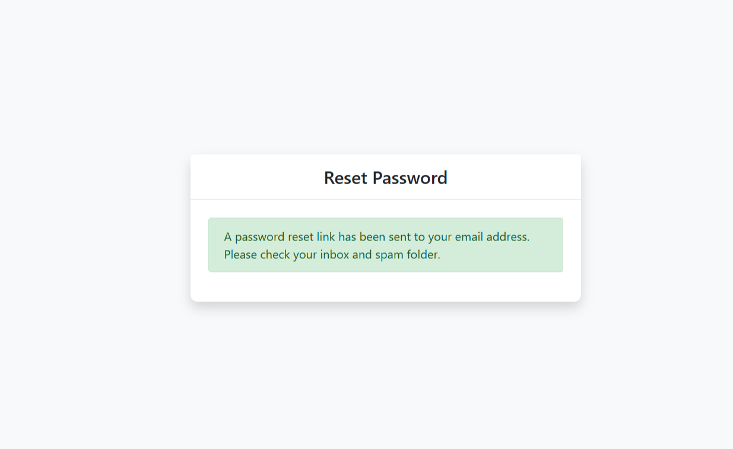
Login Account Module
3. Forgotten Password:
If a user forgets their password, they can click on the "Forgotten Password?" link.
This link typically directs the user to a password reset process where they can enter their registered email address.
The system then sends a password reset link or a temporary password to the user’s email address on file.

Slide 16
How user management security account?
. Improved Security
Reduces Account guess Risk: By stopping further attempts, it minimizes the chances of an attacker guessing the correct login credentials.
Password Reset: Users are more likely to use the "Forgot Password" feature after realizing their account is locked, which helps ensure they regain access through a secure process.
User Trust: Knowing that their account will be locked after multiple failed attempts can increase user trust in your platform's security measures.

Slide 17
Advantage Examination Module
The answer will save automatically if student forget click on submit test or the time limited is finish ;make save also .
We make a alert to student before the time limit finish to make a submit and solve quickly .
Student can see all details of result of test through pie chart how many question is correct and wrong and see the accept answer.
When the student starts the exam the timer will start automatically and show the student how much time is left.
can back to previous question after solved it .

Slide 18
Dashboard Module
Only administrator and instructors can access this module.
administrators and instructors can :
-add and edit student details .
-view marks and examination reports .
-view the student list .
-manage user details, course details, and exams .

Slide 19
Question Bank Module
Questions bank will have a program to
-add, modify and delete questions from subject.
-Instructor can add any type of questions manually by writing .
-can add fixed questions was created on previous tests by clickable and select the question and make assign .

Slide 20
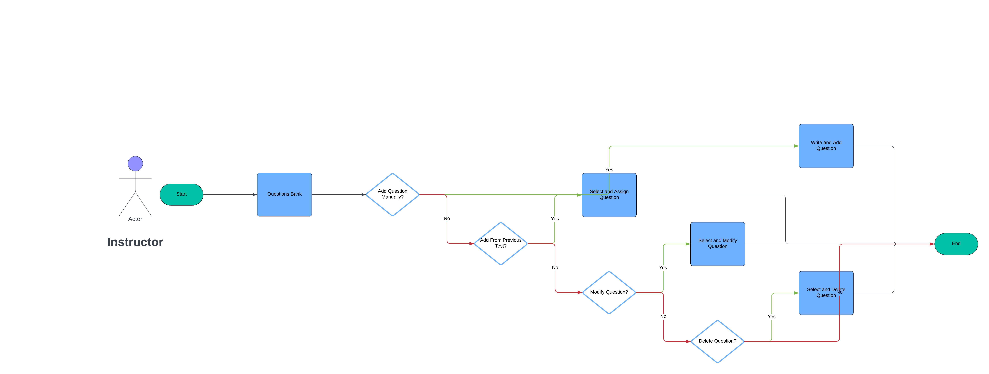
Question Bank Module Flow Chart

Slide 21
User Characteristics
There are 3 kinds of users in the proposed system.
1-Admin: The administrator is the main user of the system, and he can control complete website.
2-instructors : Prepares questions, creates exams, and manages groups.
3-Student: Takes quizzes and sees results .

Slide 22
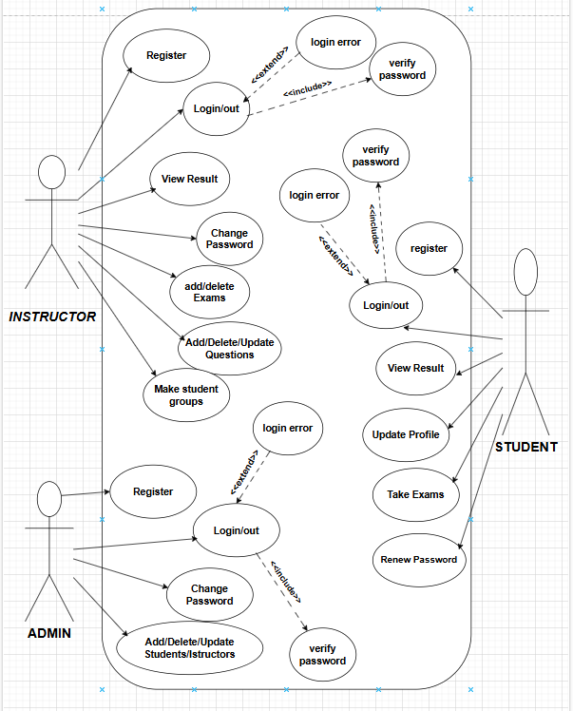
USECASE DIAGRAM

Slide 23
ADMIN DETAILS
1.register: to be authenticated first have to be registered.
2.login: the registered user can be allowed to view inner details for which he permitted privileges .
3.change password&forgot-password: user has rights to modify his login details & also be informed through mails if he is unable to login.
4.student -modifing details: user can be modified to change status of each user. ( add - suspended – reactivated – remove ).
5.instructor details-modifying details: according to staff he can add or suspended instructors or remove.
6. can view results and download it and can update his profile (name – email – phone – password ).

Slide 24
STUDENT DETAILS
1-register:to be authenticated first have to be registered.
2-login:the registered user can be allowed to view inner details for which he permitted.
3-forget password and renew password by email .
4-can see his group: student can join group when instructor add it
5-update profile : student can update profile (phone – his email – his password )
6-take exam- multiple choice ,essay, true/false: the registered student allowed to start the exam.
7-solve the exam on test session durations
8-see exam results :after completion of exam he can view at his result..

Slide 25
INSTRUCTOR DETAILS
1.register : to be authenticated first have to be registered.
2.login : the registered user can be allowed to view inner details for which he permitted.
3.change password & forget password :user has rights to modify his login details& also be informed through mails if he is unable to login.
4. add a course and his topic (title of lecture ).
5. make a group study and generate codes to student join by code or added by in
6.add questions-departments verifing
7.update questions : if any corrections in data of questions he can modify them
8.create exams : he will be prepared schedule for exams
9. assign a test & exam to groups and view exam details- view no of registered students

Slide 26
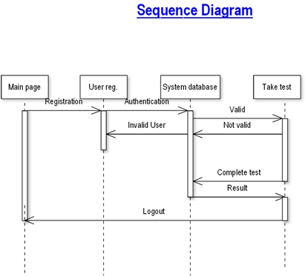
SEQUENCE DIAGRAM

Slide 27

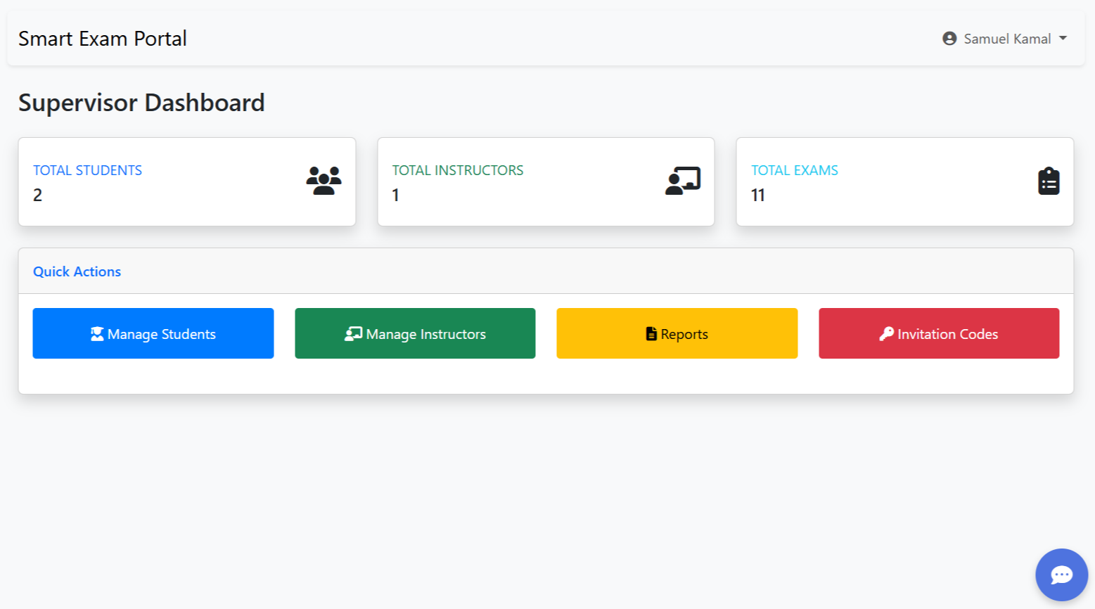
Admin Outputs

Slide 28
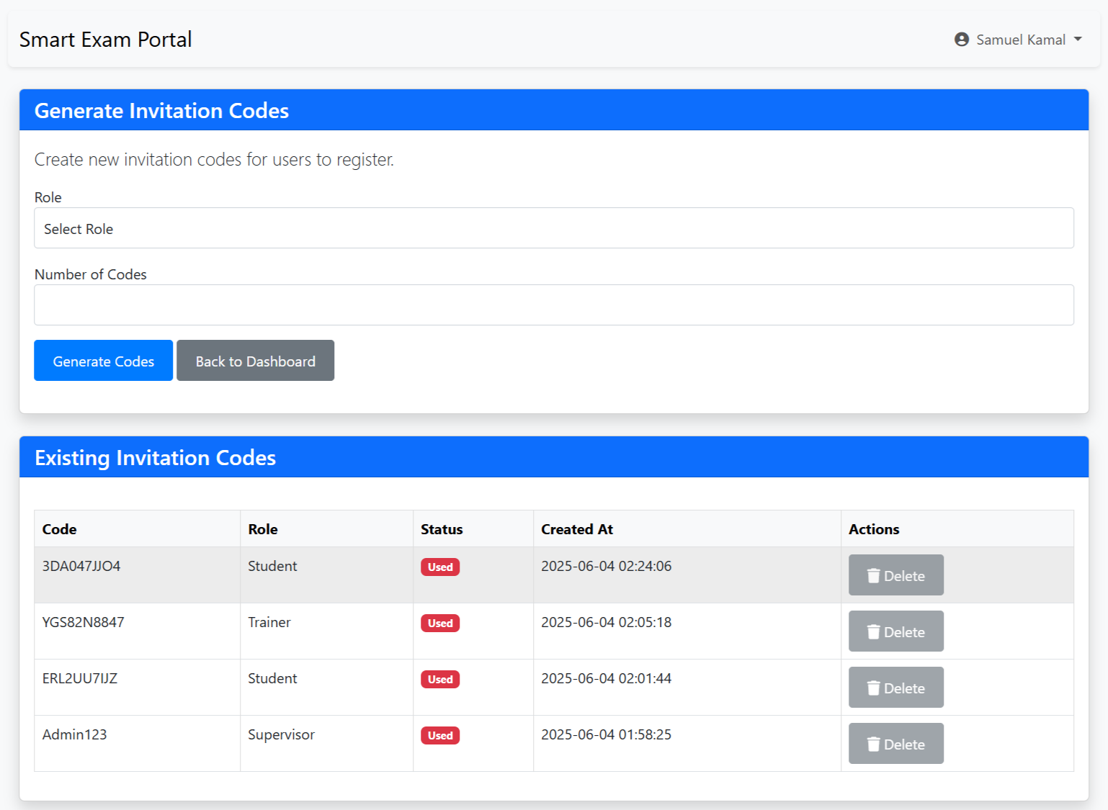
Admin Outputs

Slide 29
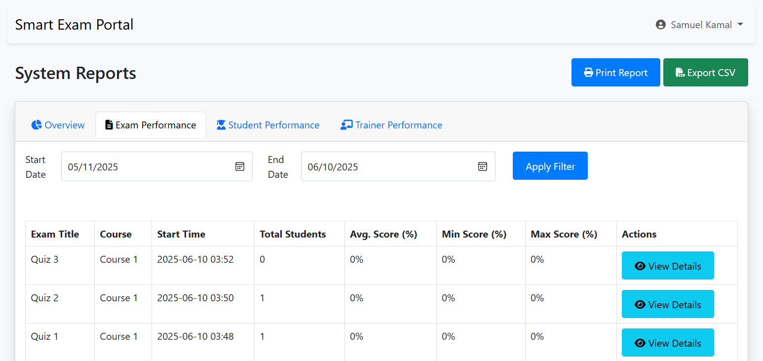
Admin Outputs

Slide 30
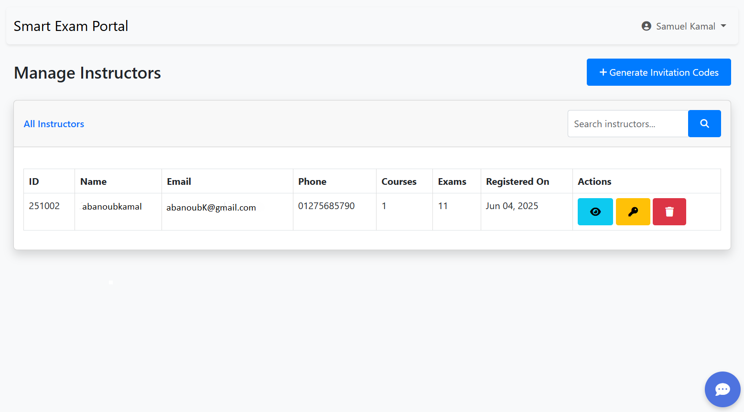
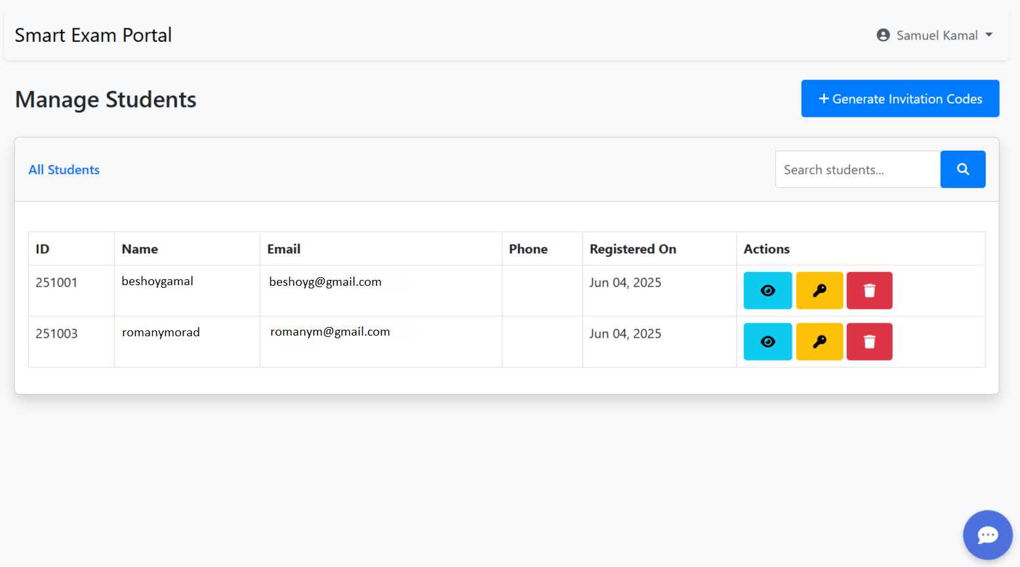
Admin Outputs

Slide 31
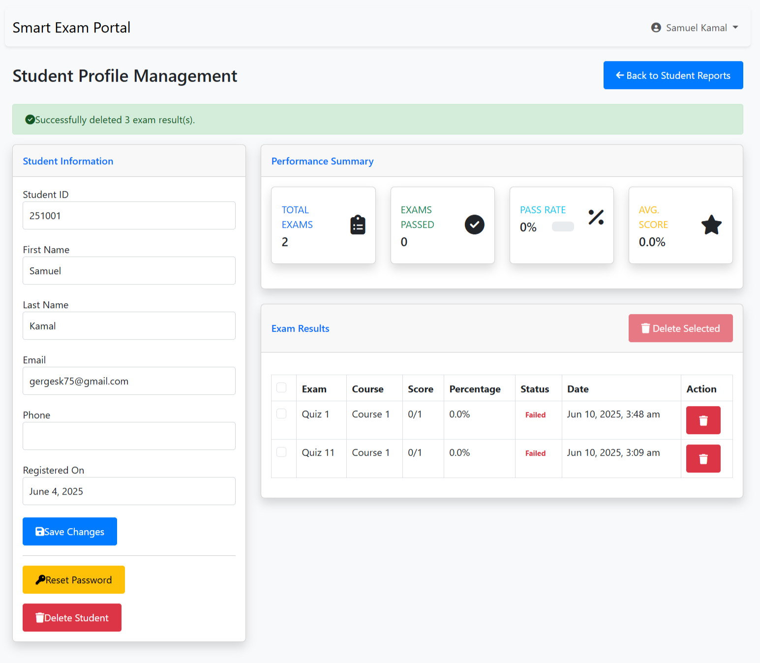
Admin Outputs

Slide 32
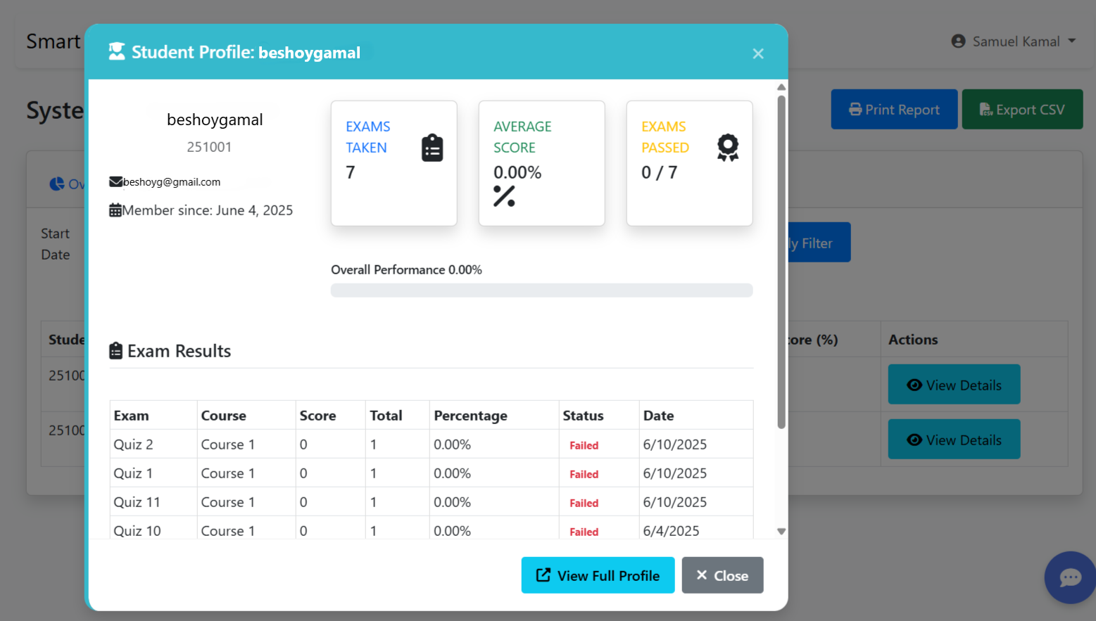
Admin Outputs

Slide 33
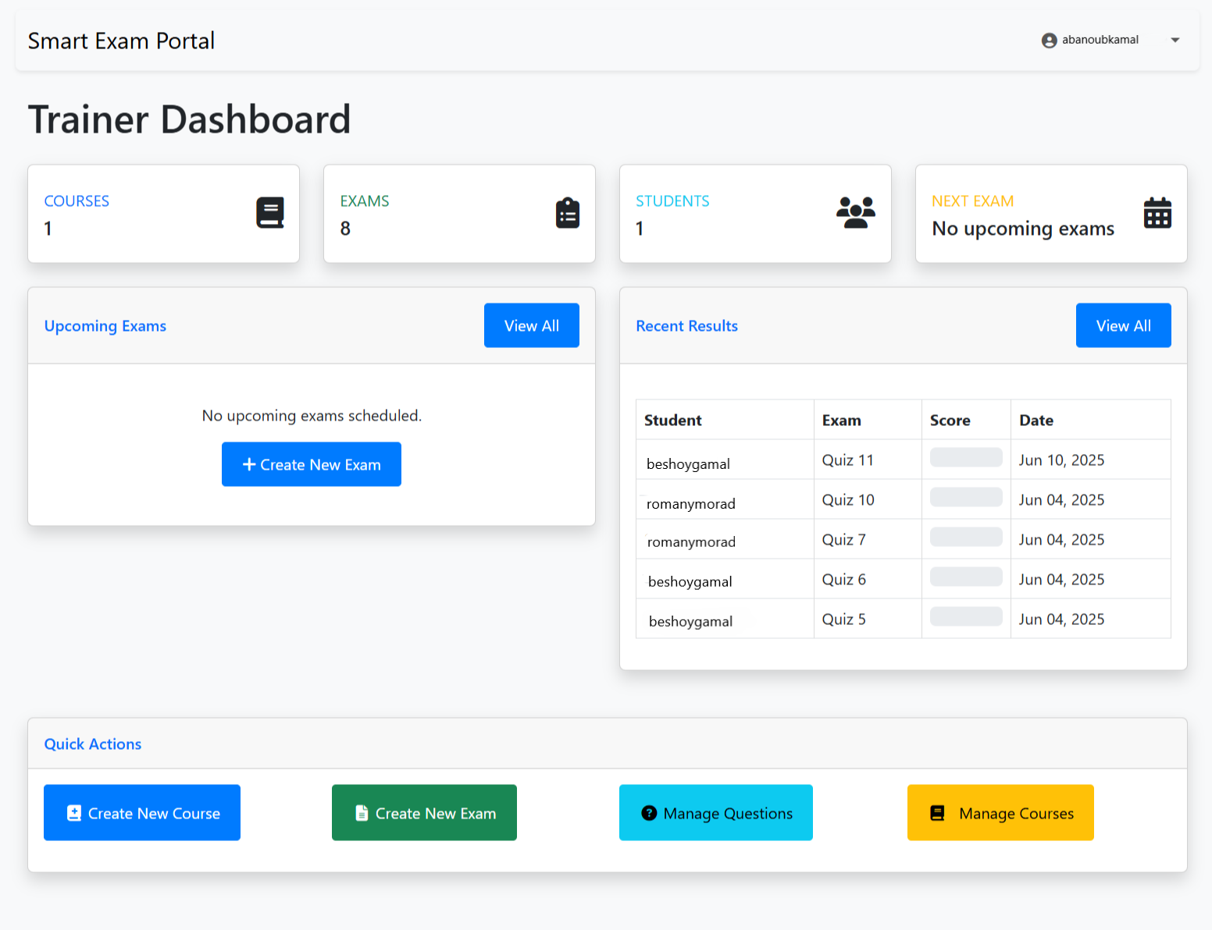
Teacher Outputs

Slide 34
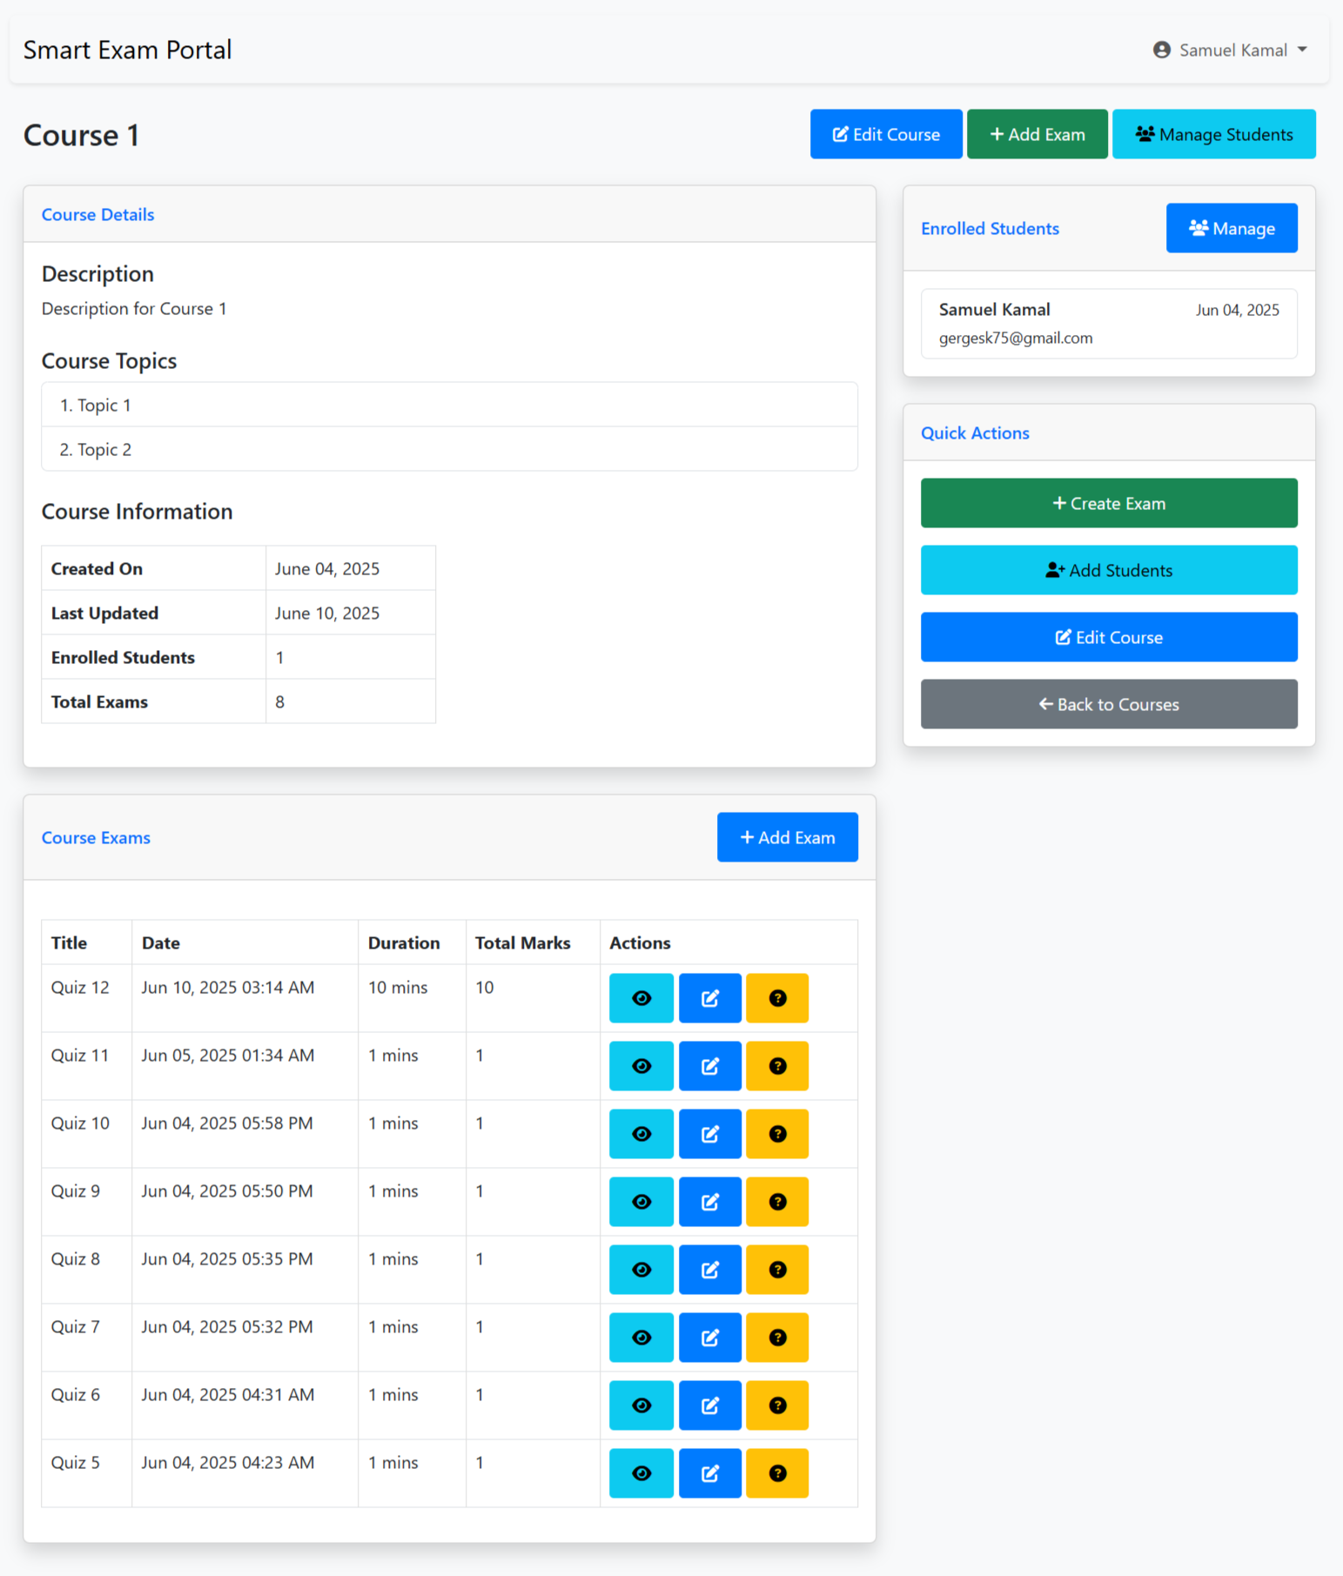
Teacher Outputs

Slide 35
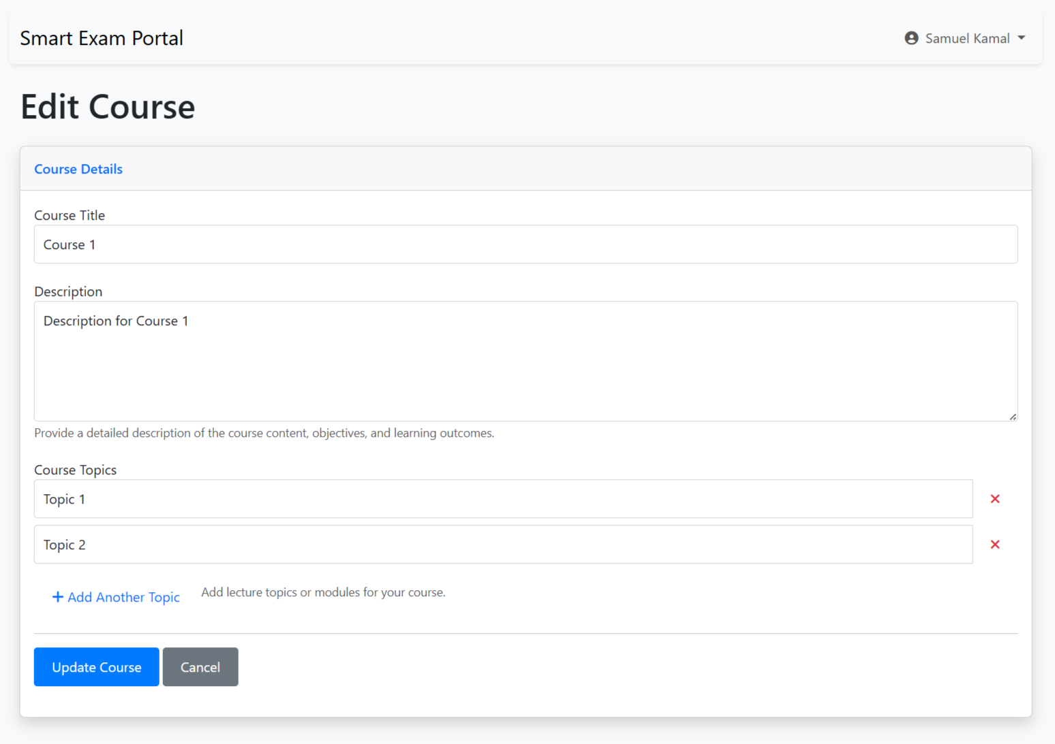
Teacher Outputs

Slide 36
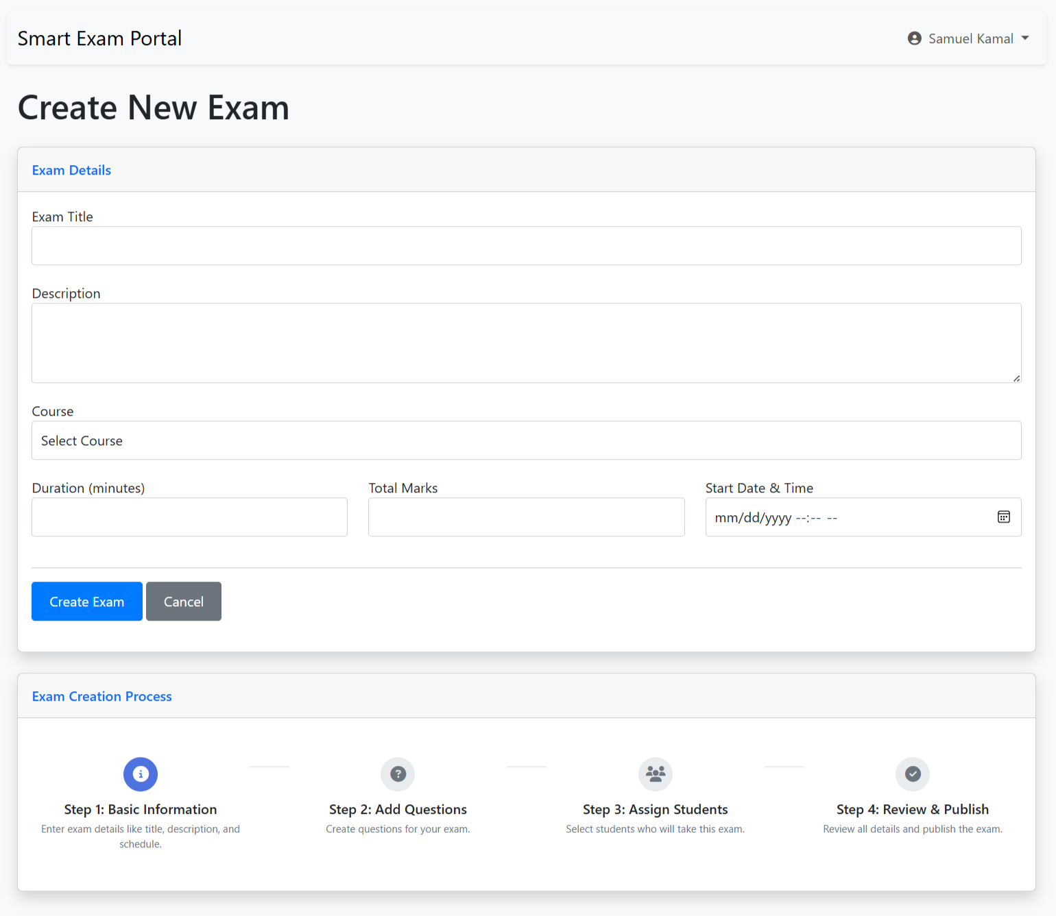
Teacher Outputs

Slide 37
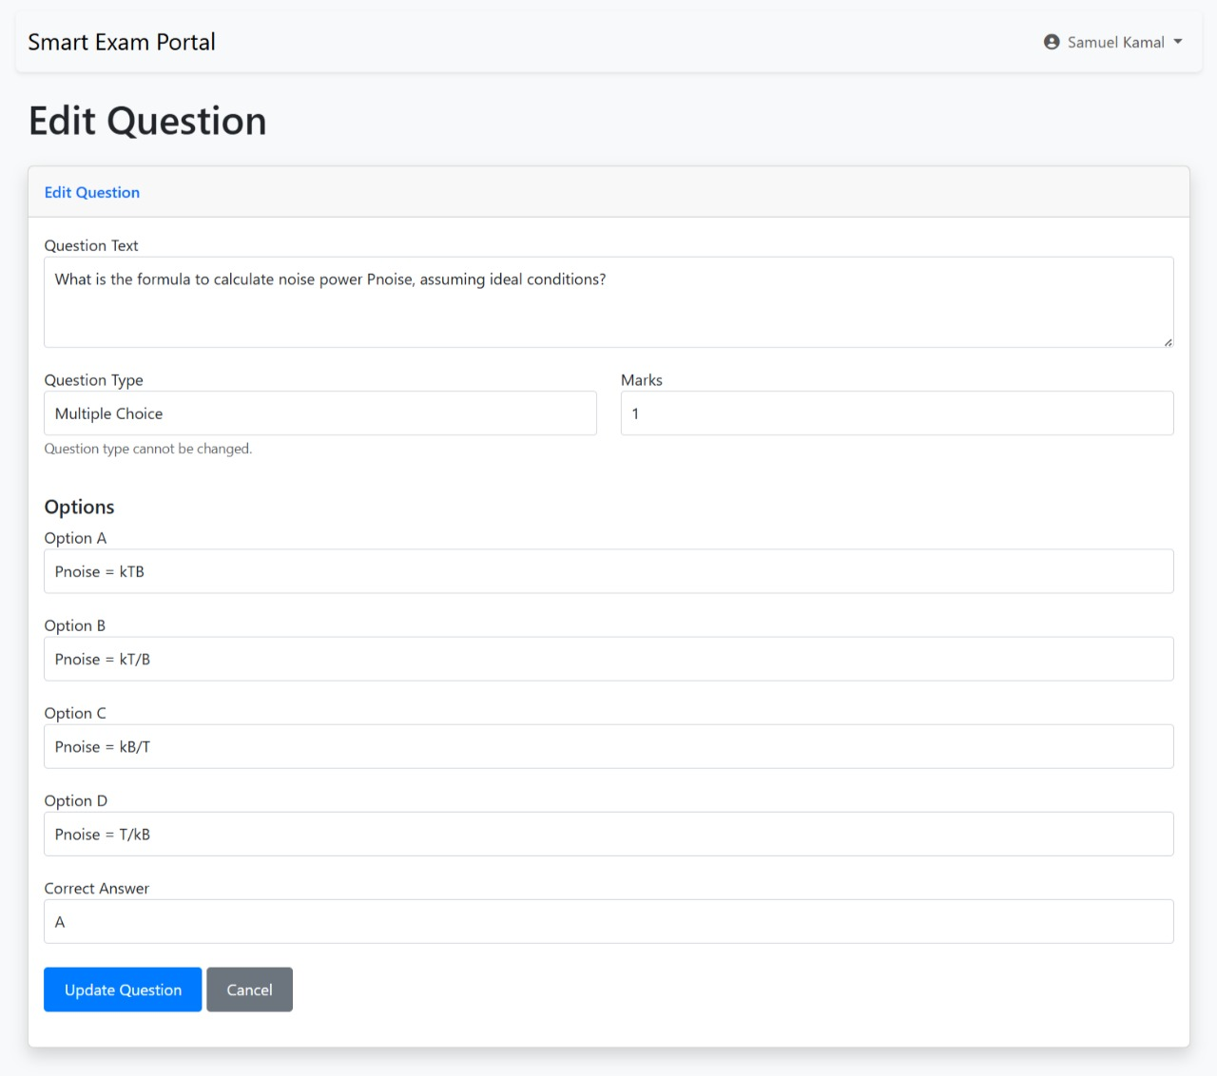
Teacher Outputs

Slide 38
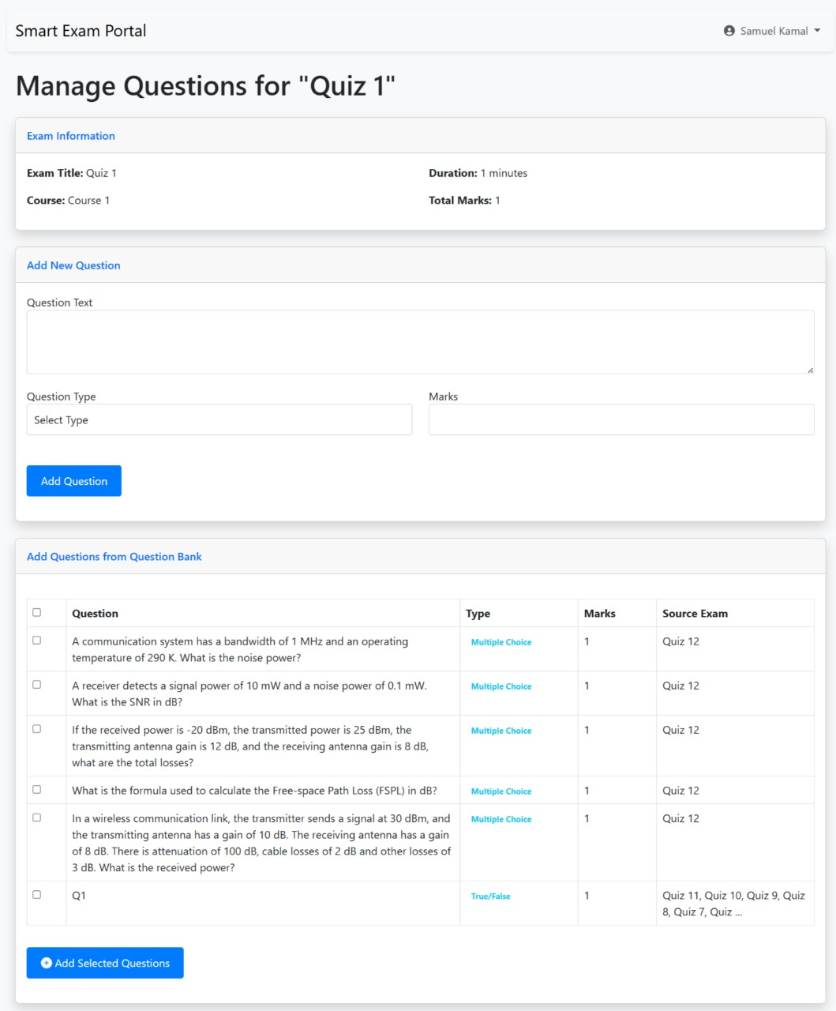
Teacher Outputs

Slide 39
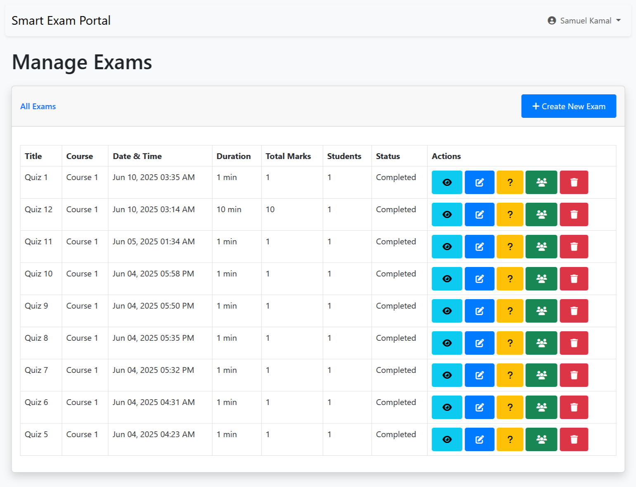
Teacher Outputs

Slide 40
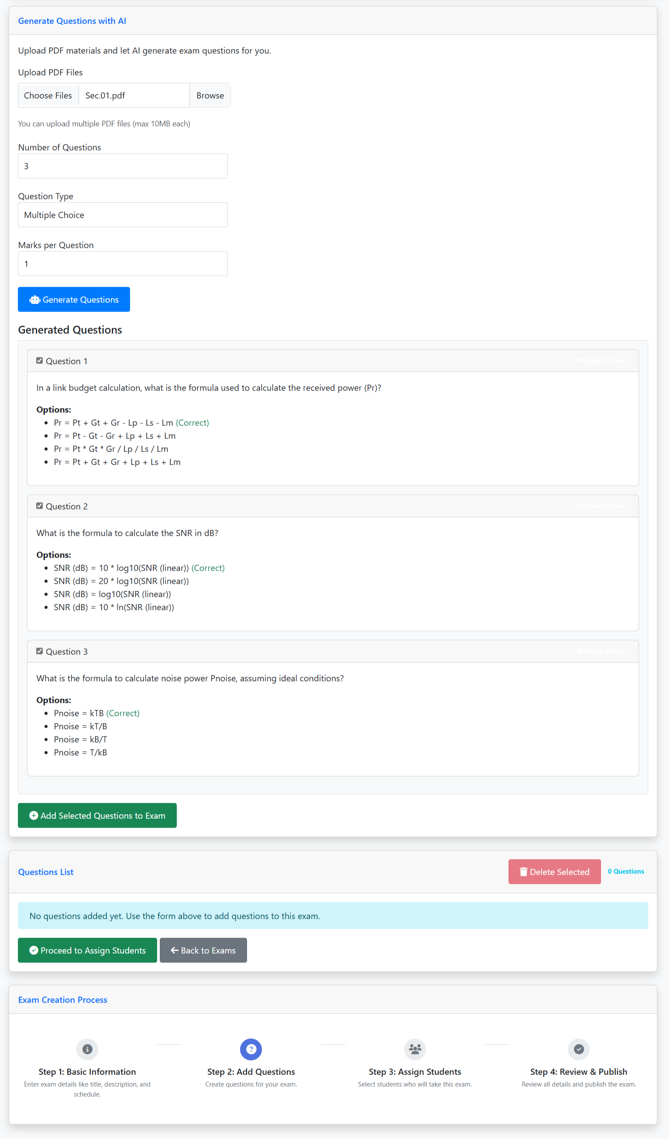
Teacher Outputs

Slide 41
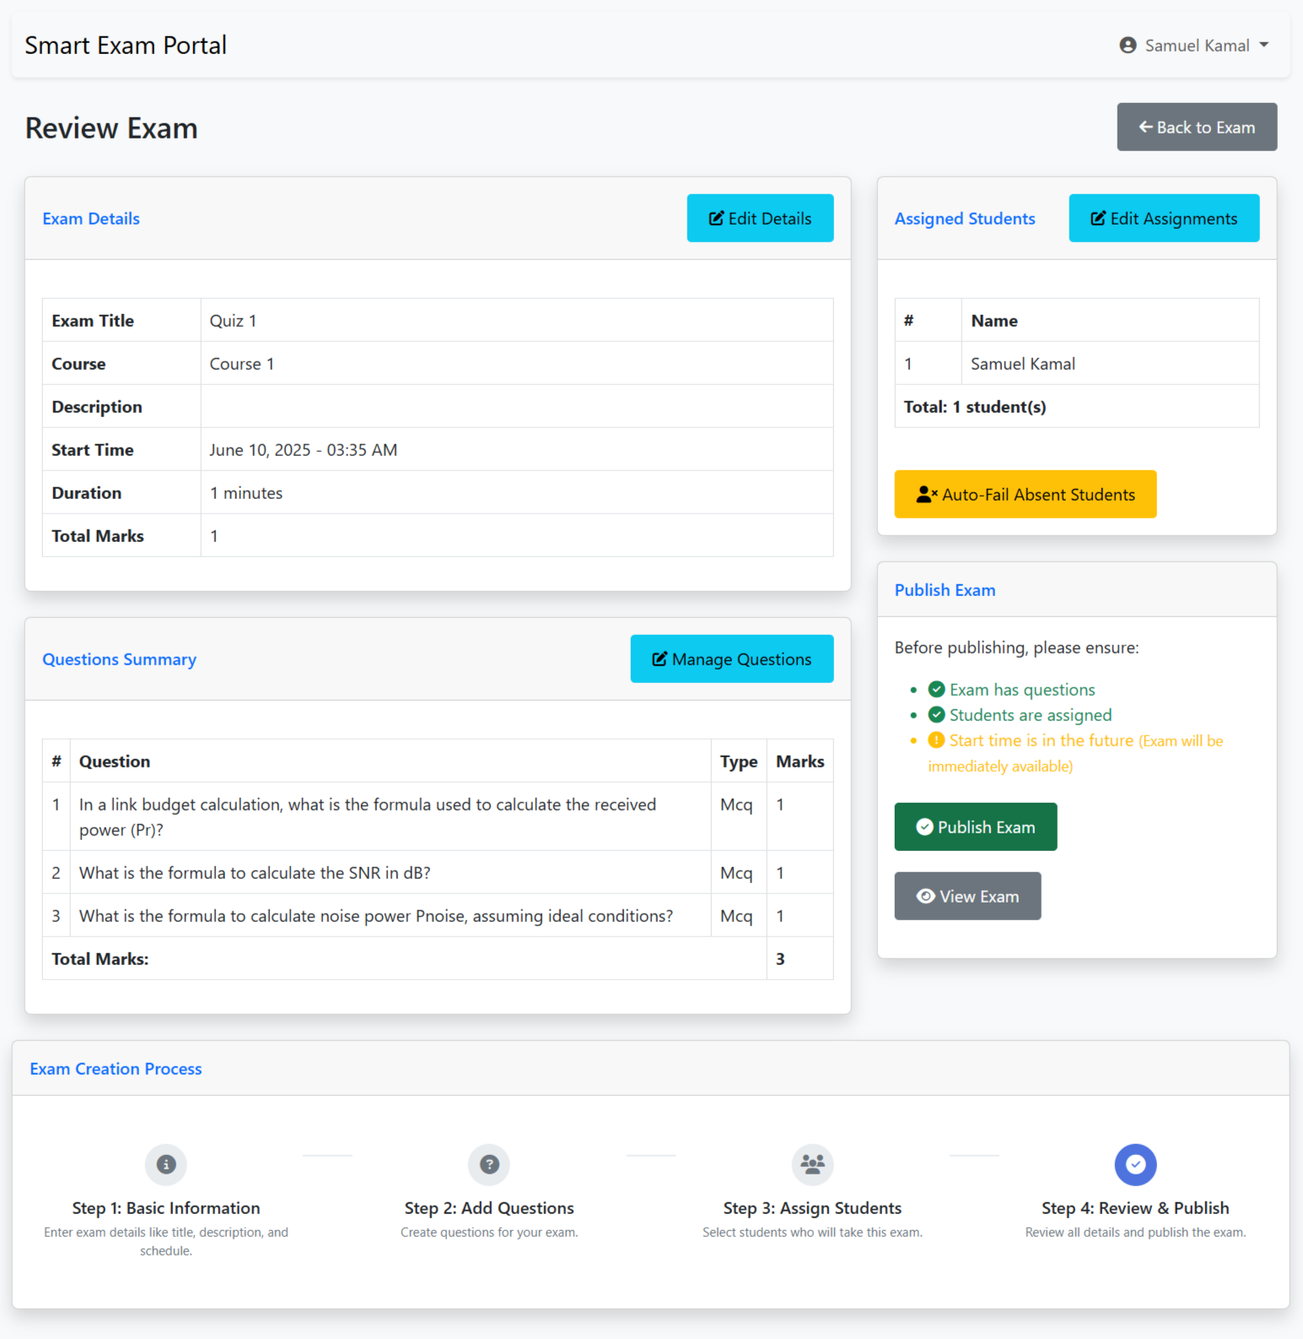
Teacher Outputs

Slide 42
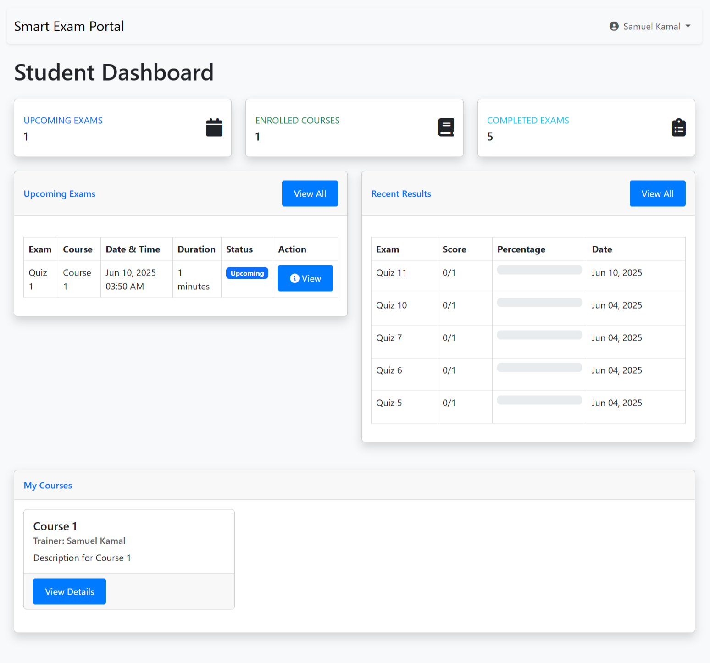
STUDENT OUTPUTS

Slide 43
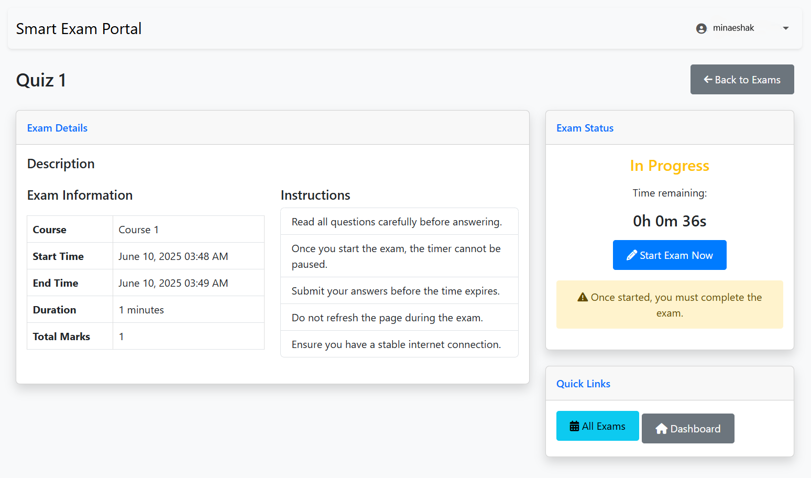
STUDENT OUTPUTS
View the details of test

Slide 44
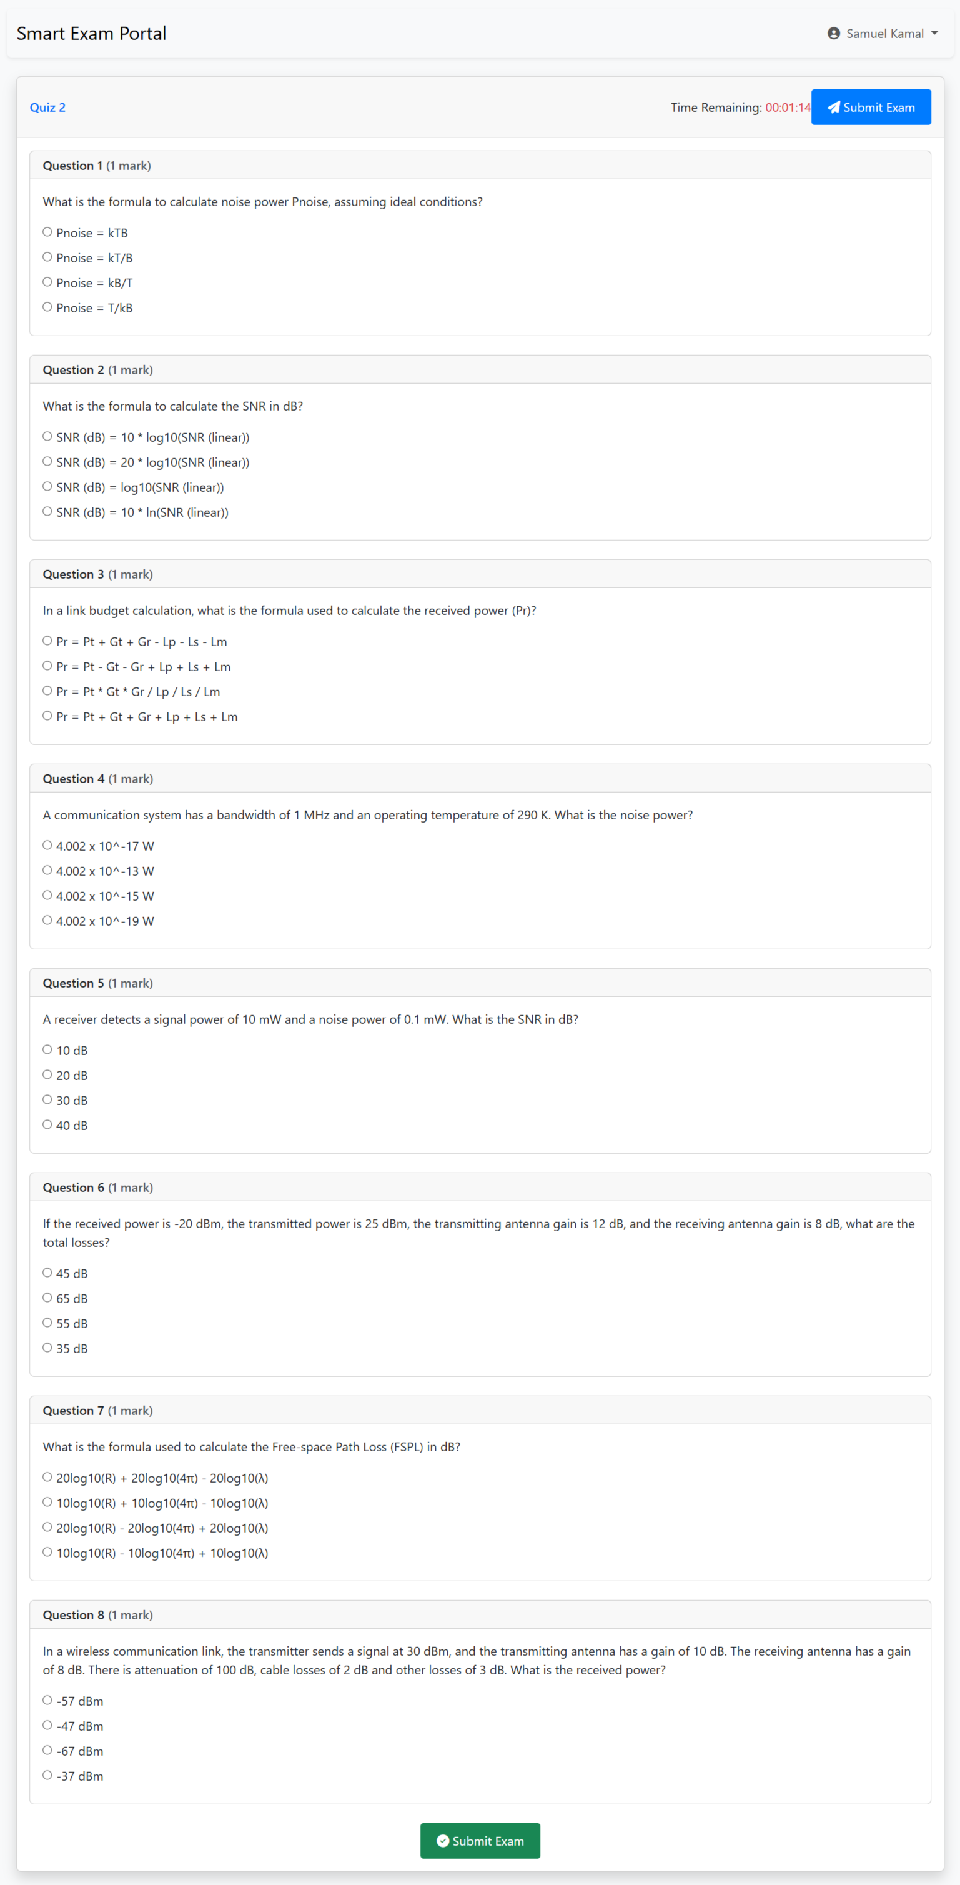
STUDENT OUTPUTS

Slide 45
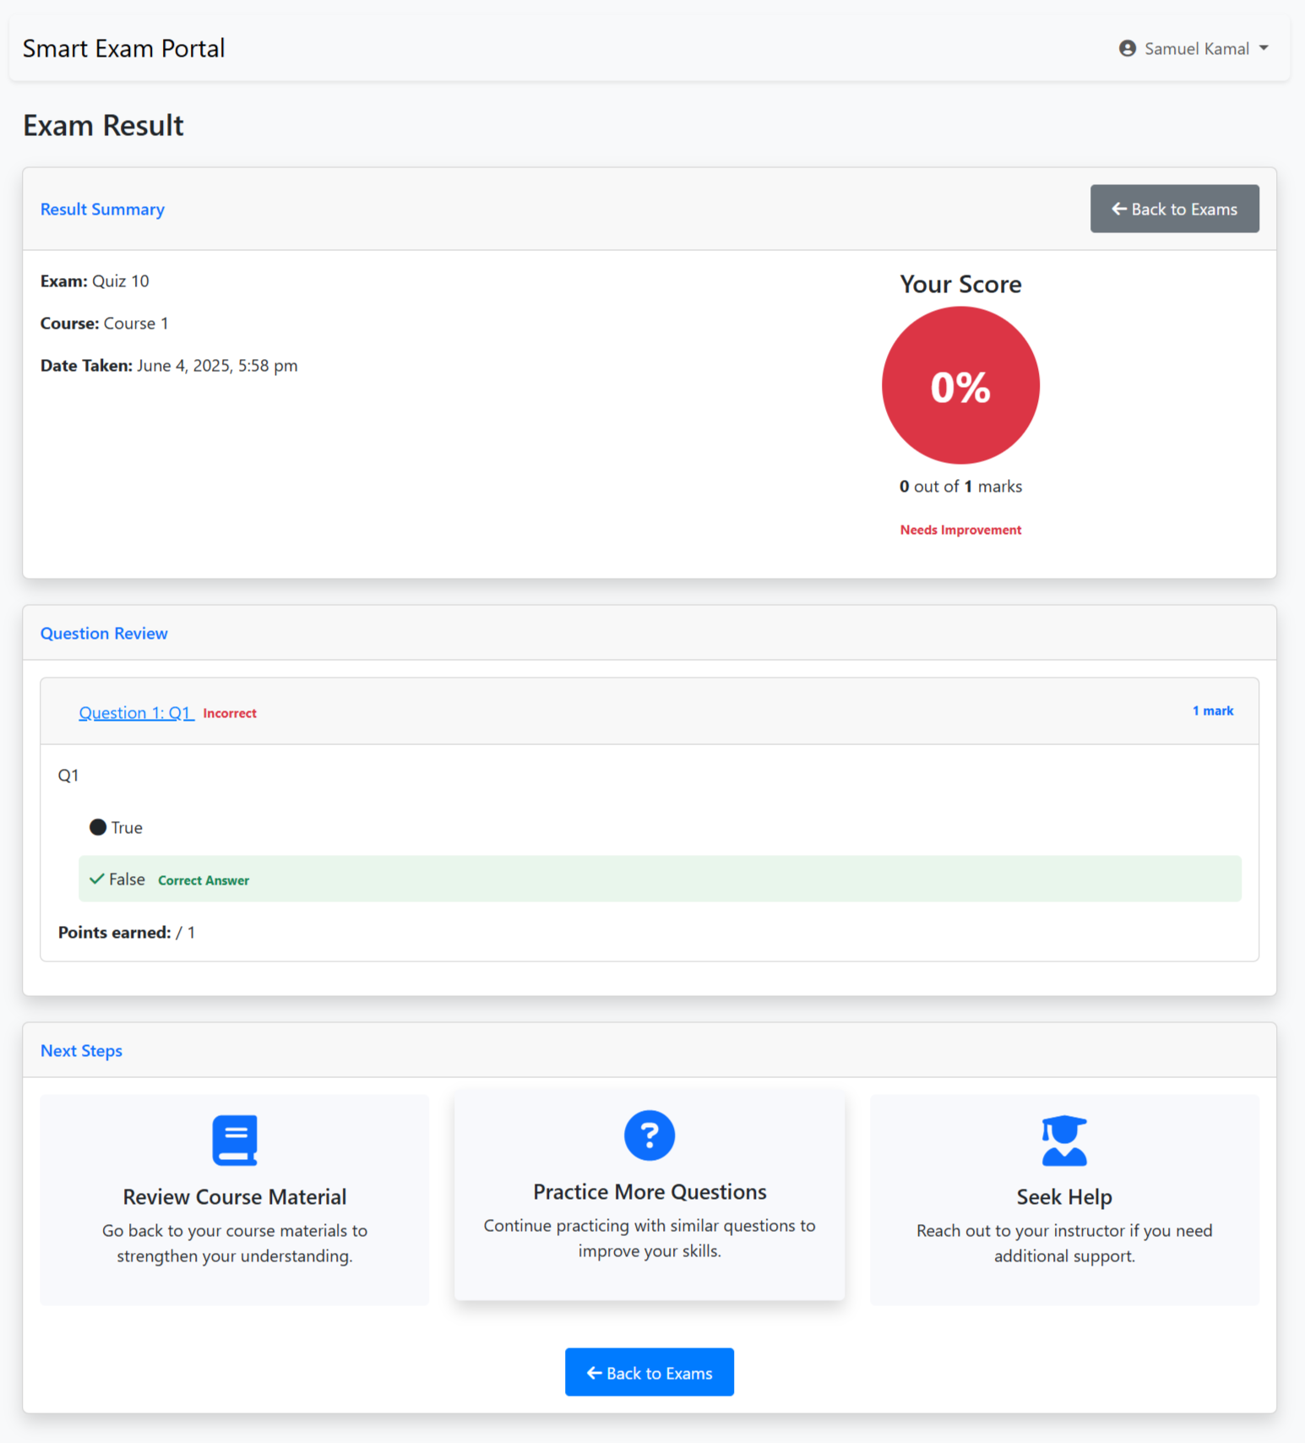
STUDENT OUTPUTS
View the result of test
End Exam

Slide 46
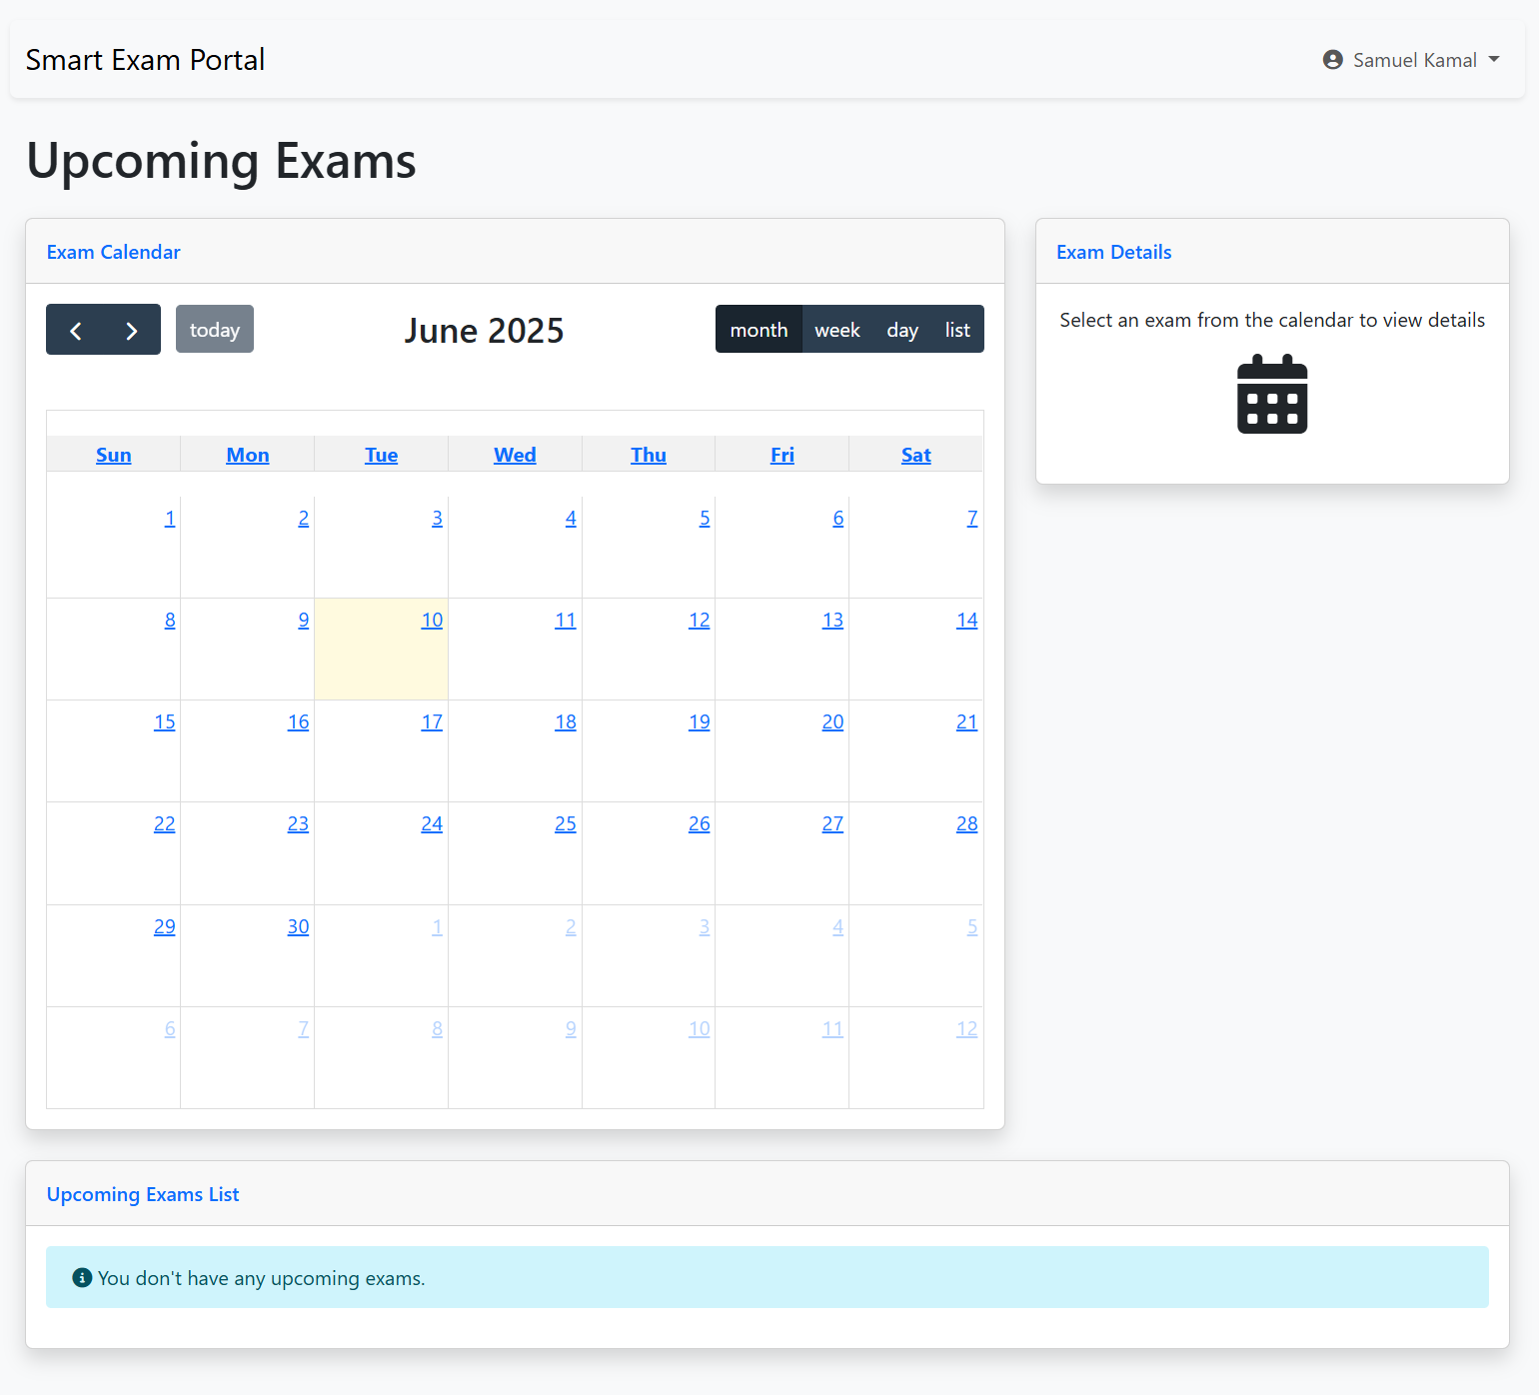
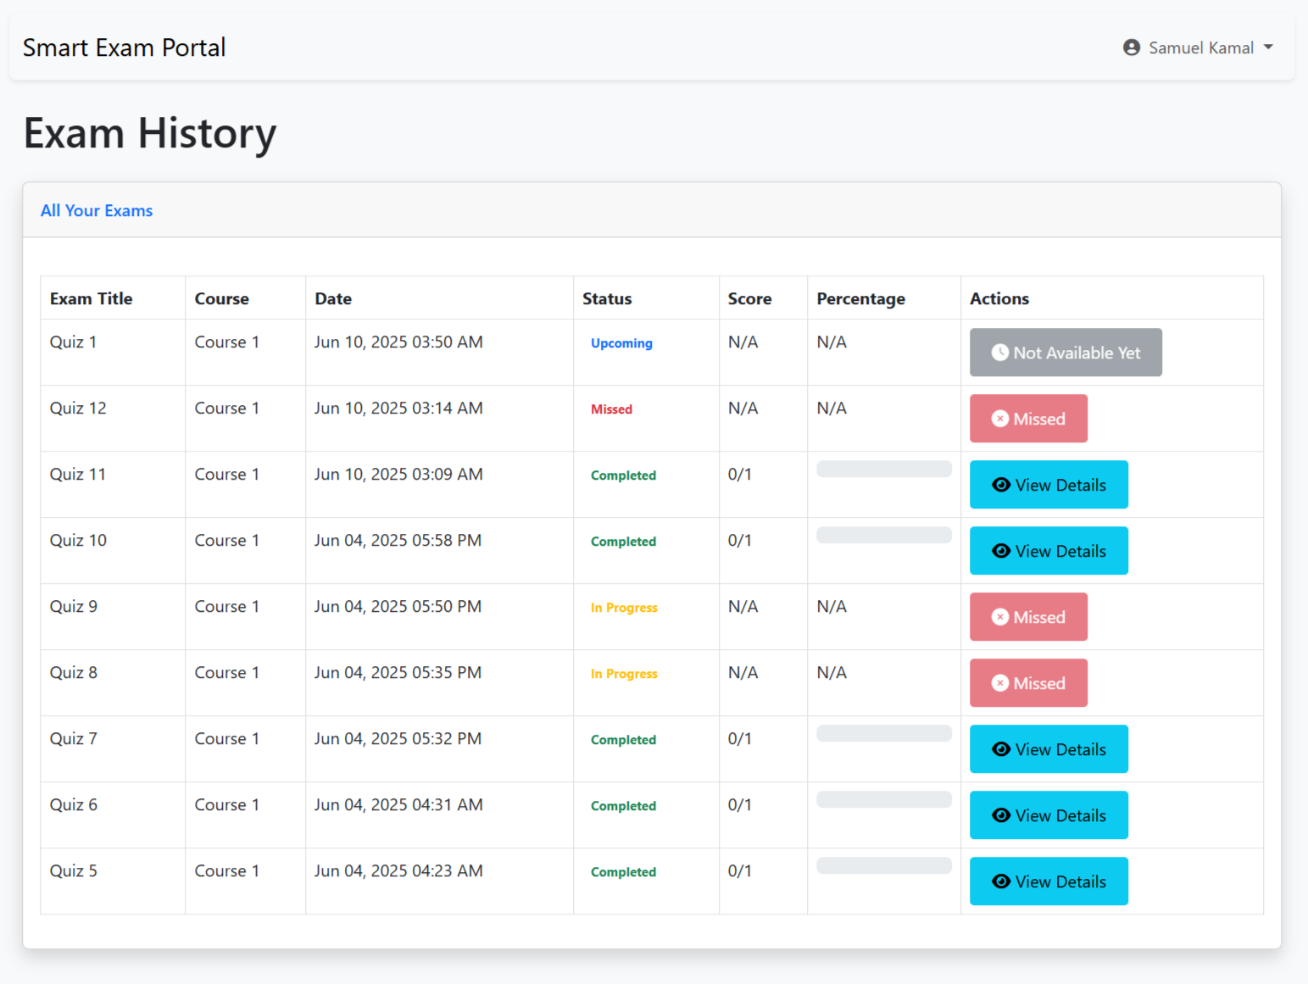
STUDENT OUTPUTS

Slide 47
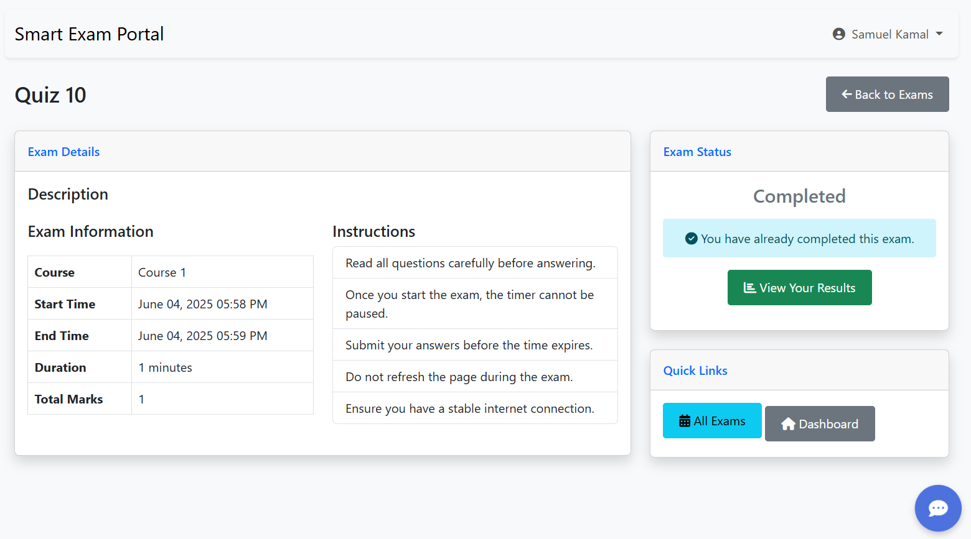
STUDENT OUTPUTS

Slide 48
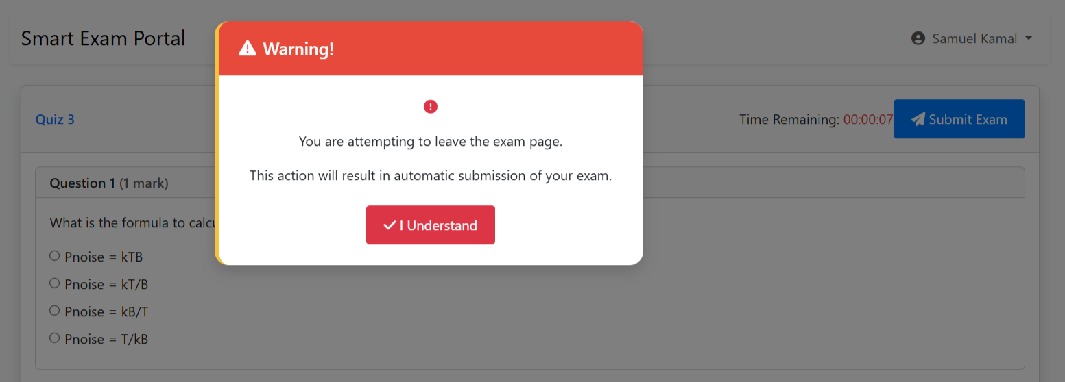
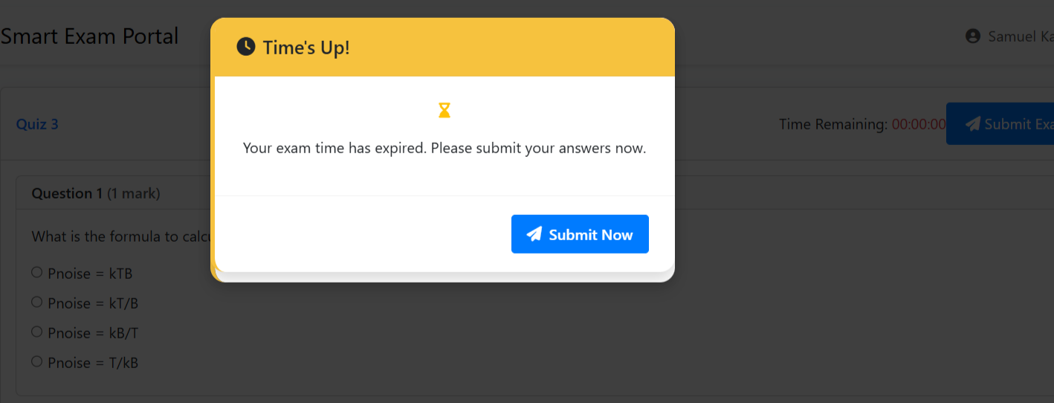
STUDENT OUTPUTS

Slide 49

Future Work had been done
The enhancement that we can add by first term comments by doctors:
• Use AI to create and manage Exams .
• Use AI to add questions automatically.

Slide 50
Future Work had been done
• complete the website frontend and backend .
• adding a chatbot integration help students with system navigation .
• adding a survey form student to send his feedback about his satisfied .
• adding a contact us form for any user on the website if face any problem .
• adding an algorithm to prevent cheating.

Slide 51
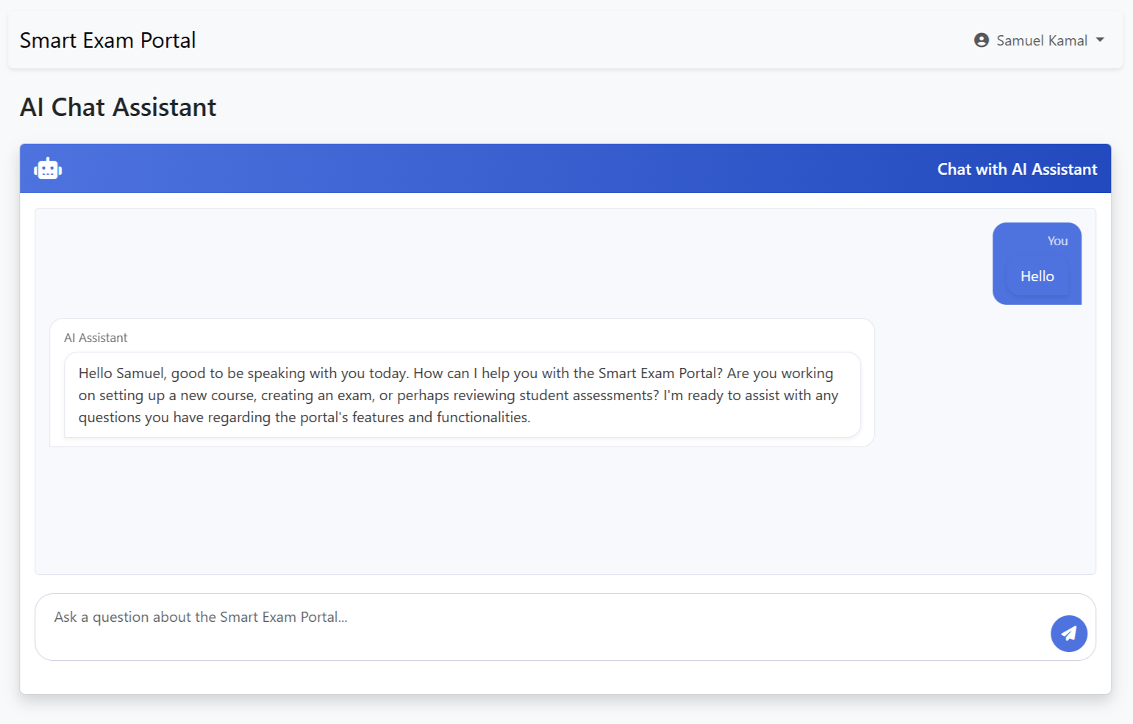
Future Work had been done
• adding a chatbot integration help students with system navigation .
• AI Chatbot Assistant: Context-aware responses based on user roles .

Slide 52
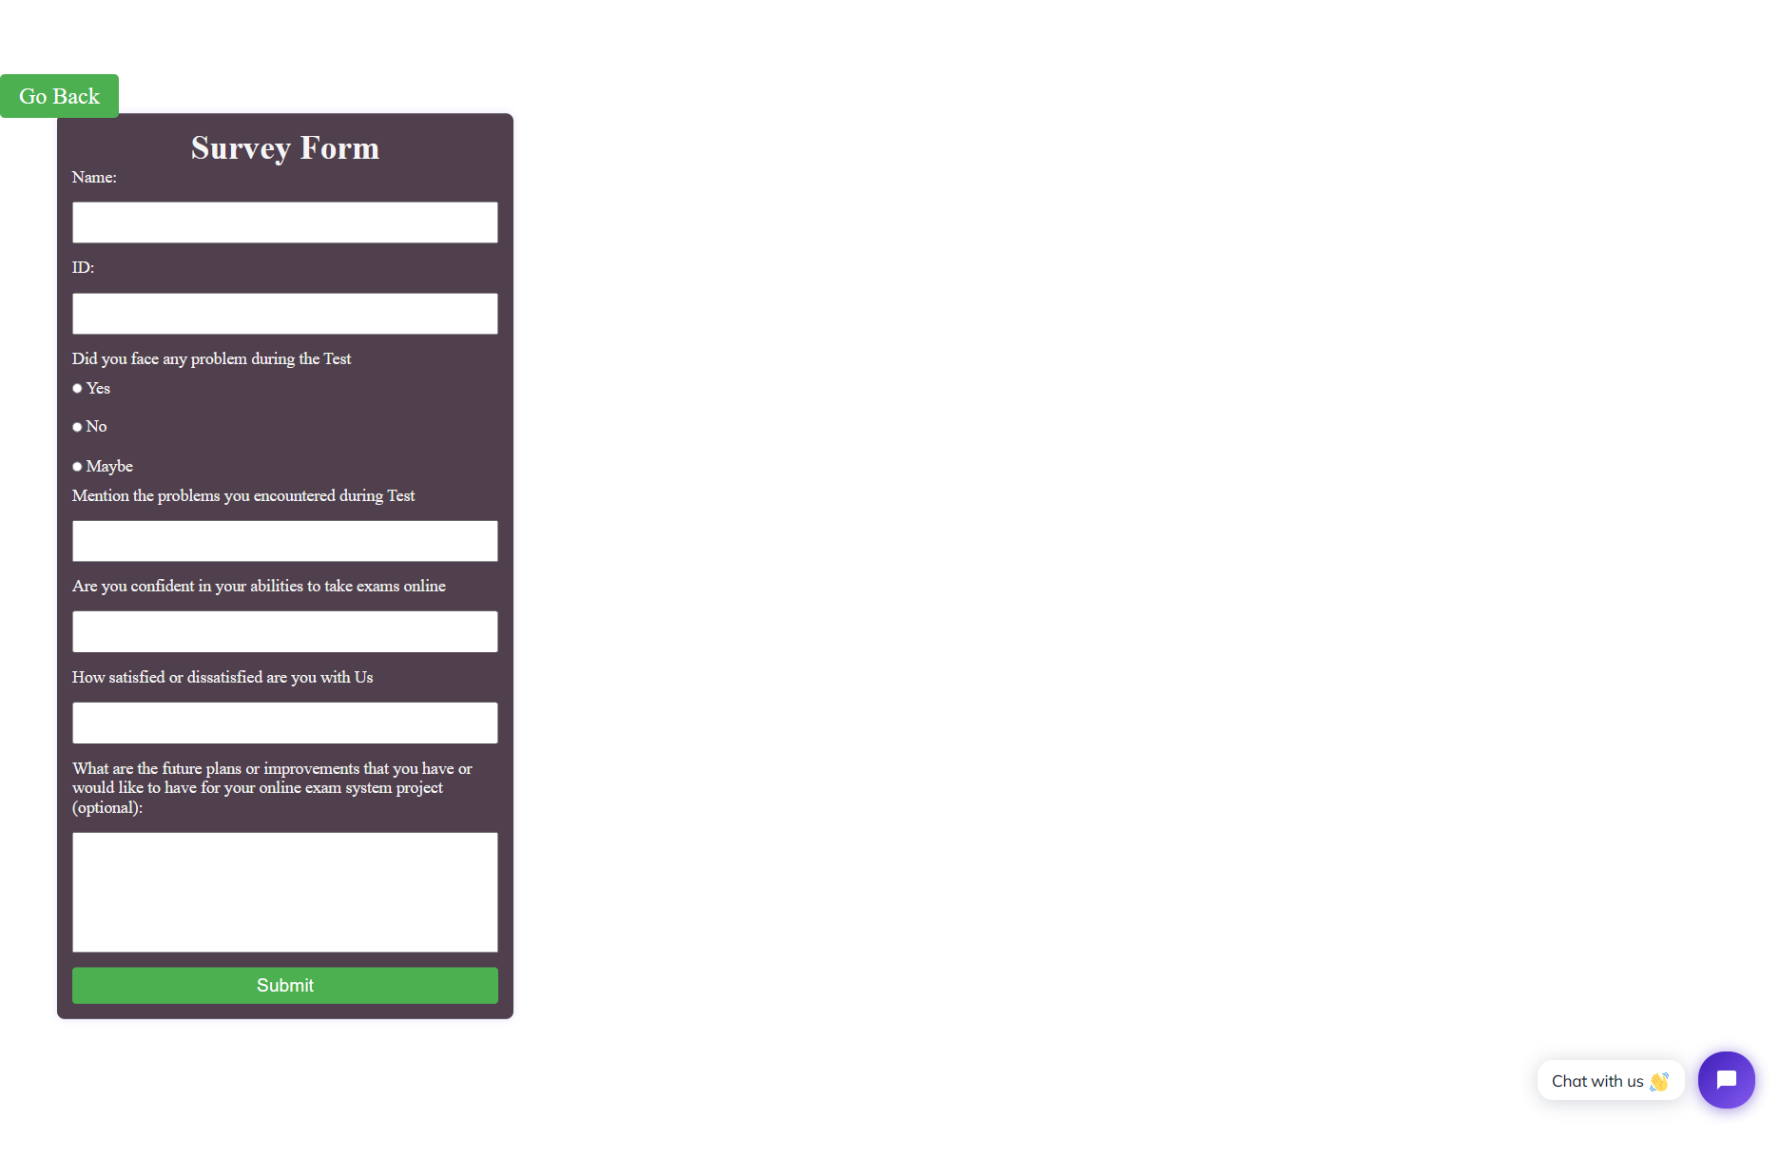
Future Work had been done
• adding a survey form student
to send his feedback about his satisfied.

Slide 53
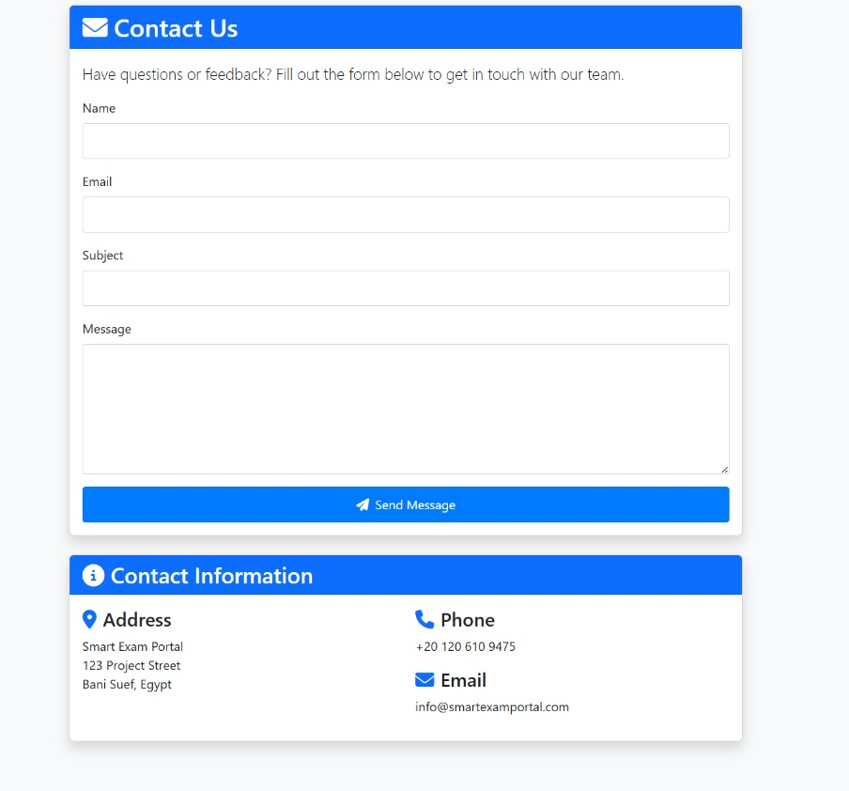
Future Work had been done
• adding a contact us form for any problem .

Slide 54
Future Work had been done
• adding an algorithm to prevent cheating.

Slide 55
Future Work
• Mobile Application Development .
• AI-based Performance Analysis.
• Proctoring Feature for Exam Integrity Using webcam.
• Camera-Based AI to analysis body language .
• Online Payment Integration.
• For Special Needs Students add : Screen Reader Compatibility and Speech-to-Text (Voice Typing) and Text-to-Speech (TTS) Functionality and Sign Language Videos for Instructions and Dedicated Support Contact.

Slide 56


THANK
YOU

